Slide 1
Using Processing for Data Visualization
A Presentation By: Noah Dunn

Slide 2
Goals for Today
I want you to understand data visualization and good practices to creating it
I want you to understand how to create visualizations in Processing
I want you to see an example of what you can do with what I am about to teach you

Slide 3
I will put slides for questions in sporadically, so let me know if you have a question!
Let’s Go!

Slide 4
Data Visualization
Turning Numbers into Pictures

Slide 5
What is the point?
The information age is here. Massive collections of data rule daily conscience
People want information and they want it quickly
Hundreds of Millions of Rows of Columns does not offer nearly as much a picture on first glance.

Slide 6
Data Visualization History Timeline
Humans make note of celestial bodies, geometric diagrams, and surveying land data.
The Computing Age gives way to computer drawn, interactive, programmatic visualizations
1800s
Ancient Times - 1700s
1970s
Hand-drawn bar graphs, line graphs begin to emerge as data-driven diagrams

Slide 7
Modern data visualization is used to present intricate and elaborate data in a concise and clear format.

Slide 8
Data Visualization Principles
Transmit a large amount of information to the brain quickly
Take advantage of the human brain’s ability to identify patterns and communicate relationships and meaning
Inspire new questions and further exploration
Identify additional sub-problems from the data
Identify trends and outliers or otherwise interesting data points

Slide 9
Data Visualization Best Practices
There is no universal set of “Best Practices”
Every field has their own set of acceptable practices
There are some very general rules for academic research

Slide 10
Data Visualization Best Practices (Cont.)
Create the simplest visualization that conveys all desired information
Focus on either visualizing patterns or details
Select an appropriate color scheme based on the data
Aggregate large data sets in a meaningful way

Slide 11
Checkpoint
Any questions?
The Purpose of Data Visualization
The History
Principles
Best Practices

Slide 12

Processing
Data Visualization made Easy/ier
Image covered by CC

Slide 13
Why Processing?
Many other kinds of data visualization software offer one of two experiences
Lots of developer control, but programming is complicated
Little developer control, but programming is easy
Processing aims for both

Slide 14
History of Processing
Created by two MIT students, Ben Fry and Casey Reas in 2001
Intended to be a first programming language option for those interested in graphics programming
Free and Open-Source
Current version is Processing 3

Slide 15
Downloading and Installing
Full download can be found here.
Unzip the download and run the file called “Processing.exe”

Slide 16
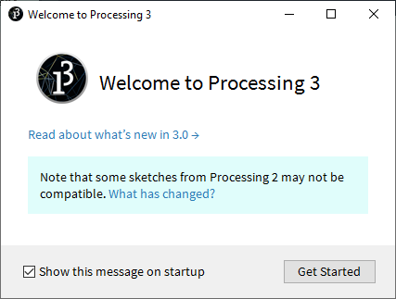
Hit Get Started

Slide 17
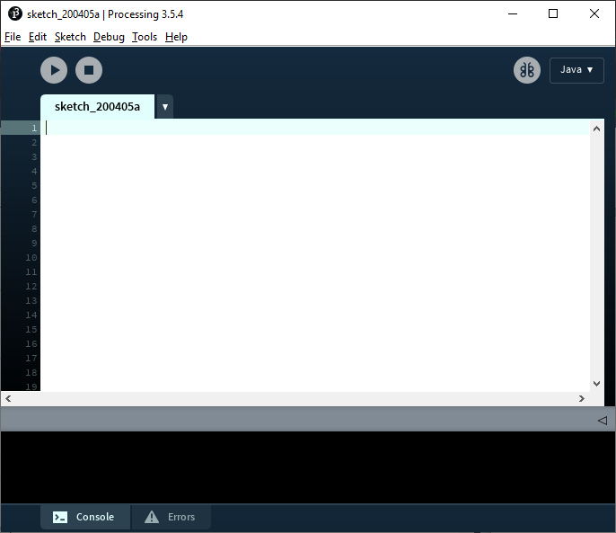
Success!

Slide 18

Run and Stop
Language Selection
Sketch Creation
Debugger Mode
Console Output

Slide 19
Versions of Processing
Processing has versions for many popular programming languages + platforms
Python
Javascript
Android
Raspberry Pi
For today’s discussion, we will use Java

Slide 20
Additional Notes
In Processing, “programs” are referred to as ‘sketches’.
Running any sketch will automatically create a new window called the ‘sketch window’ where all graphical output will go.

Slide 21
Checkpoint
Any questions?
Processing’s History
Installation
The IDE
Versions
(We are about to jump into very code heavy discussion)

Slide 22
Writing Code in Processing 3
Like cutting through butter
Image covered by CC

Slide 23
There is NO main Method in Processing
Java
public class HelloWorld {
public static void main(String[] args) {
System.out.println("Hello World!");
}
}
Processing
println("Hello World!");

Slide 24
Aren’t we here to learn about pretty pictures?

Slide 25
YES
But, we need to build up a foundation before we make pretty pictures

Slide 26
We use setup and draw Instead of main
setup
Used to declare values of global variables
Sets the size of the output screen
Set the frame rate of the sketch
Executes before draw or any user defined function
draw
Runs 60 times per second by default (can be changed in setup)
After each loop, everything in the output frame is cleared
Anything to be drawn needs to be called from here

Slide 27
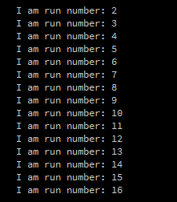
First Console Program
int x;
void setup() {
x = 2;
size(300, 300);
frameRate(30);
}
void draw(){
println("I am run number: " + x);
x++;
}

Slide 28
Using the Console
Anything that would output to console in java will output to console in Processing
The console can be a useful tool for debugging the ‘business logic’ code, or checking data being read.
The majority of the code should be used to modify the output sketch frame

Slide 29

The Processing Coordinate Grid
(0, 0)
(99, 99)
For a 100x100 sized sketch

Slide 30
First Drawing Methods
strokeWeight
Takes numeric input to determine the size of the ‘brush’
color
Primitive type in Processing.
Accepts RGB values as input
stroke
Sets the color of the ‘brush’
point
Takes an x,y numeric pair as input. Draws a point at that location of strokeWeight size and stroke color

Slide 31
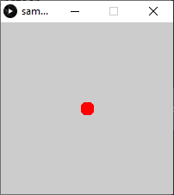
Drawing a Dot
void setup() {
size(200, 200);
frameRate(30);
}
void draw() {
// Set the radius of the point to 15 pixels
strokeWeight(15);
// Create the color red using standard RGB values
color red = color(255, 0, 0);
// Make the color of the stroke red
stroke(red);
// Put it in the middle
point(width/2, height/2);
}

Slide 32
WOW
I can do data visualization now

Slide 33
Drawing Lines and Shapes
fill
Sets the fill color for shape drawing
noFill
Declares that the succeeding shapes will not be filled in
circle
Takes an x, y, and radius numeric value and draws a circle at that x,y of size radius
line
Takes an x1,y1 pair alongside a x2,y2 pair and draws a line between them

Slide 34
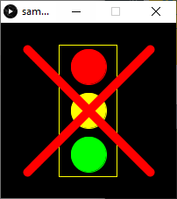
Drawing a Traffic Light
void setup() {
size(200, 200);
frameRate(30);
}
void draw(){
// Changes the background color to black
color black = color(0, 0, 0);
background(black);
// Set the desired colors up
color red = color(255, 0, 0);
color yellow = color(255, 255, 0);
color green = color(0, 255, 0);
//The Top Circle is Red
strokeWeight(1);
stroke(red);
fill(red);
circle(width/2, height/4, 40);
//The Middle Circle is Yellow
stroke(yellow);
fill(yellow);
circle(width/2, 2 * height/4, 40);
//The Last Circle is Green
stroke(green);
fill(green);
circle(width/2, 3 * height/4, 40);
//Drawing a yellow box around the circles
// Disable the fill function to draw an outline
noFill();
stroke(yellow);
rect(width/3, height/8, width/3, 6 * height/8);
// Draw two thick red lines
stroke(red);
strokeWeight(10);
line(30, 30, 170, 170);
line(170, 30, 30, 170);
}

Slide 35
Checkpoint
Any questions?
Setup and Draw
Colors, strokeWeight, stroke, point
Fill, noFill, shapes, lines

Slide 36
Alright. We can draw pretty pictures. But what about the data?

Slide 37
Data Functionality
loadStrings
Load all strings from a specified text file into an Array of strings
loadTable
Load all CSV data in from a specified CSV file into a ‘Table’ class
PImage
Reads an image into an object that can modified, pixel by pixel, in a programmatic fashion
map
Transforms a value from one scale into another
Ex: map(55, 0, 100, 0, 1000) -> 550.0

Slide 38

Reading in Data from Plaintext and CSV
words.txt:
cheese
gravy
a biscuit
void setup() {
size(200, 200);
frameRate(30);
String[] words = loadStrings("words.txt");
// The header flag indicates that the csv file's first line is the name of the headers
Table table = loadTable("names.csv", "header");
int nameNumber = 0;
for (TableRow row : table.rows()){
println(row.getString("name") + " wants " + words[nameNumber]);
nameNumber++;
}
}
names.csv:
id,name,number
0,Noah,17
1,Nick,20
2,Josh,13

Slide 39
Using PImage
// Size cannot use variables as arguments, they must be literals
size(792, 422);
float xPosition = 0.0;
float yPosition = 0.0;
// The position where the first image ends
float xPosition2 = chicagoMapLight.width;
float yPosition2 = 0.0;
image(chicagoMapLight, xPosition, yPosition);
image(chicagoMapDark, xPosition2, yPosition2);
}
PImage chicagoMapDark;
PImage chicagoMapLight;
// The Chicago map is a 792 x 844 pixel image
void setup() {
chicagoMapLight = loadImage("ChicagoMap.PNG");
// This scales the image to half size while keeping the width/height aspect ratio
chicagoMapLight.resize(0, 844/2);
chicagoMapDark = negative(chicagoMapLight);

Slide 40
Using PImage (cont.)
// in result, store darker version of what is in source
for(int i = 0; i < source.pixels.length; i++){
// First, extract the rgb components of the source image:
float r = red(source.pixels[i]);
float g = green(source.pixels[i]);
float b = blue(source.pixels[i]);
float avg = (r + g + b) / 3;
result.pixels[i] = color(255 - avg, 255 - avg, 255 - avg);
}
return result;
}
/* A helper method to turn the map black/white */
PImage negative(PImage source){
PImage result = createImage(source.width, source.height, RGB);
result.loadPixels();

Slide 41
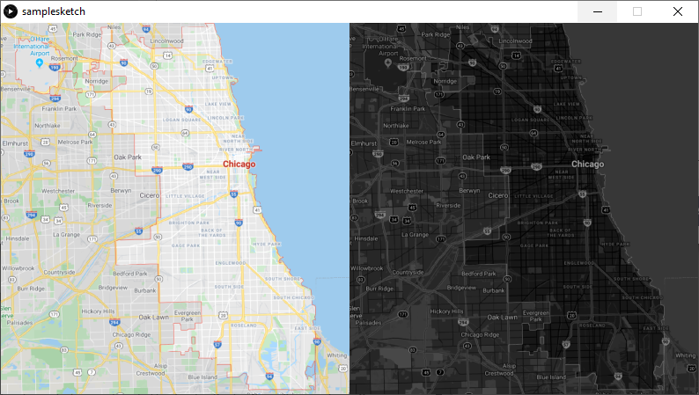
A Map of Chicago, Two Ways
Note: The map function can easily be used here to map a point in real coordinates to a point in Sketch Frame coordinates

Slide 42
Interactive Functionality
mouseX and mouseY
Two global variables that save the position of the mouse’s X and Y value in the frame at all times
mouseClicked, mousePressed, mouseDragged,
mouseReleased, mouseMoved
All mouse event action listeners included
keyPressed and keyReleased
Keyboard event action listeners

Slide 43
Shortcomings of Processing
Processing is not bulletproof
Console input from keyboard is disabled
The language runs slower than other options
Processing runs on top of the base languages, leading to speed decrease
All data processing should be done prior to running

Slide 44
Checkpoint
Any questions?
Reading Data in CSV, Plaintext
PImage
Map Function
Interactivity

Slide 45
Data Visualization Examples
Everything comes together
Image covered by CC

Slide 46
Data Visualization in Processing
OpenProcessing is a public collection of sketches from users all across the world
It offers in-browser runs of all processing sketches, alongside the source code for each sketch
The following comes from OpenProcessing

Slide 47
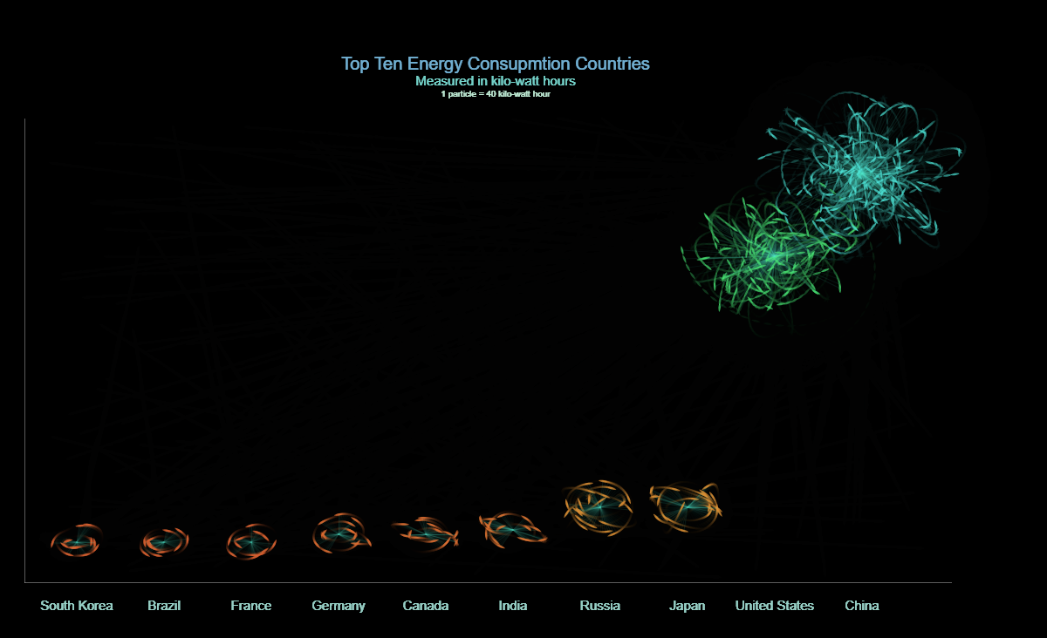
Energy Consumption Worldwide
https://www.openprocessing.org/sketch/198208

Slide 48
Best Practices + Principles Followed
The model is simple, while showing all necessary information
The model aggregates a larger dataset in a meaningful way
The model transmits a lot of information quickly

Slide 49
Techniques at Use
Uses Processing’s fill, line, rect, stroke
Also uses PVector (for particle physics) and the text method (for the headers)
152 Lines total

Slide 50
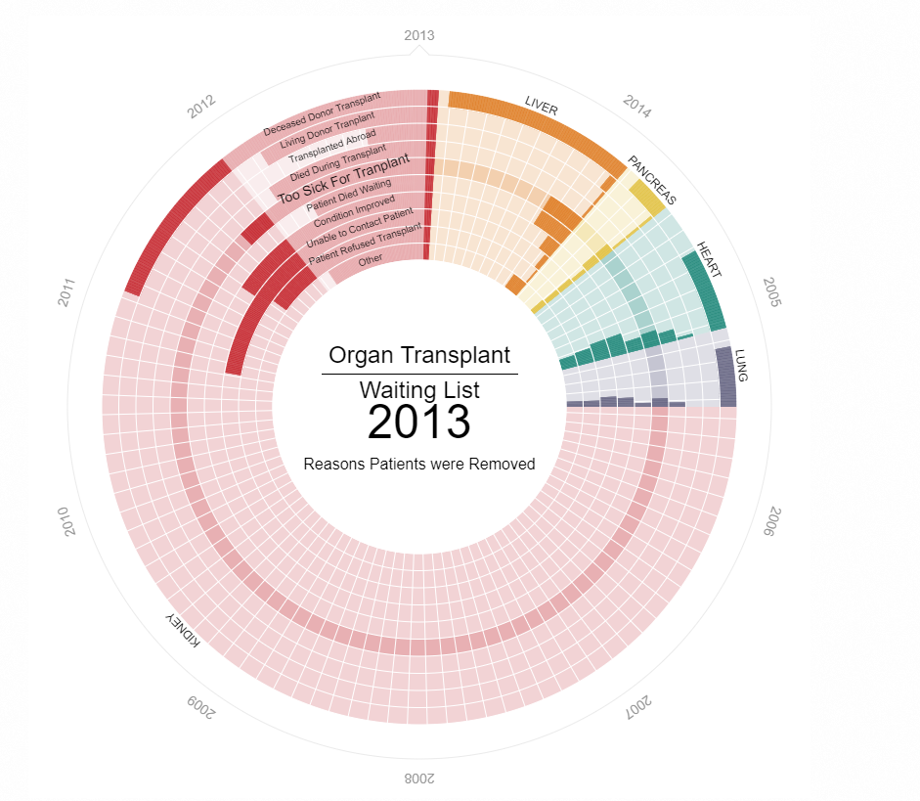
Organ Transplant Rejection
https://openprocessing.org/sketch/183729

Slide 51
Best Practices + Principles Followed
The model points out outliers, inspires new questions, and generates new sub-problems
The use of color is meaningful (a medical-looking template)
Data aggregation is shown in a meaningful way

Slide 52
Techniques at Use
Uses Processing’s loadStrings function, rect, noFill, mouseMoved, mousePressed, and some custom classes
Totals 635 lines of code

Slide 53
Recap
We discussed the purpose and practices of good Data Visualization
We viewed some good examples of data visualizations using Processing 3
We discussed how to write graphical code in Processing 3

Slide 54
Thanks! (Shoutout to Norm Krumpe for teaching me basically everything I know about Processing)
All Credit for this slide format goes to Slides Carnival under the Creative Commons license

